Slide 1
AI System for Thyroid Nodule
Classification
Malaya Sahu-38 Sandeep-47 Taha Mustafa-61

Slide 2
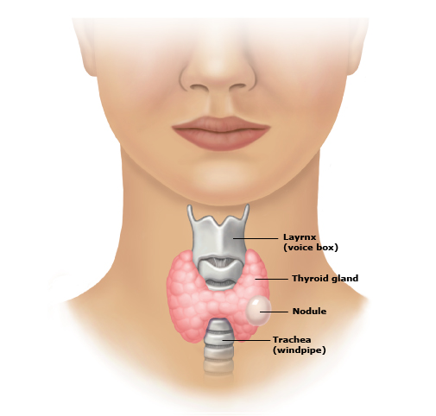
What is a Thyroid Nodule?
A thyroid nodule is an abnormal growth in the thyroid gland.
Around 68% of adults have nodules, but most are benign.
Distinguishing between benign and malignant nodules is critical for avoiding unnecessary biopsies.

Slide 3
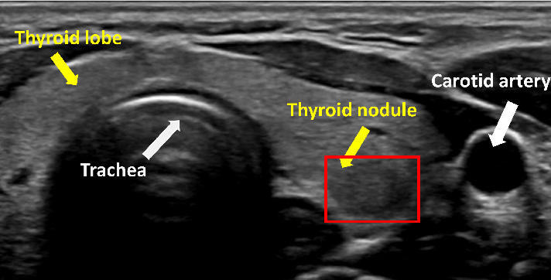
Diagnostic Challenge
Ultrasound imaging is the most common method for detection.
Diagnosis depends heavily on radiologist experience, leading to subjectivity.
AI-based Computer-Aided Diagnosis (CAD) can improve accuracy and reduce workload.

Slide 4
Dataset Details
Total Images: 5,000 ultrasound images
Classes: Benign (0) and Malignant (1)
Training: 70% (3,500 images)
Validation: 10% (500 images)
Test: 20% (1,000 images)
Source: Cancer Hospital, Chinese Academy of Medical Sciences

Slide 5
Methodology
Data Preprocessing: All ultrasound images were resized, normalized, and augmented (flips, rotations) to improve generalization and prevent overfitting.
Model Building: The project was developed progressively, starting from simple to advanced models to compare their effectiveness in classifying benign and malignant thyroid nodules.
Logistic Regression: Used as a baseline traditional machine learning model with flattened pixel features to establish a reference accuracy.
ANN (Artificial Neural Network): Introduced multiple dense layers with non-linear activations (ReLU) to capture complex relationships in the data.
CNN (Convolutional Neural Network): Built a custom CNN with convolution, pooling, and dense layers to automatically learn spatial and texture-based features from ultrasound images.
VGGNet (Transfer Learning): Used pre-trained VGG16 (trained on ImageNet) as a feature extractor and added custom fully connected layers for classification.

Slide 6
Training and Evaluation:
Each model was trained using binary cross-entropy loss,Focal Loss and the Adam optimizer.
To address class imbalance, class weighting was applied during training.
Model performance was evaluated using precision, recall, F1-score, and AUC-ROC, along with accuracy and loss.

Slide 7
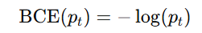
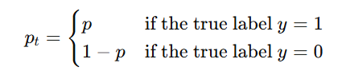
Focal Loss
For binary classification (e.g., benign = 0, malignant = 1), the standard Binary Cross-Entropy loss is:
where:
When the dataset is imbalanced, most samples belong to one class . The BCE loss gets dominated by easy examples, so the model learns less from rare benign cases.

Slide 8
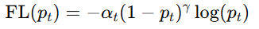
Focal Loss
To fix this, Focal Loss adds two factors to BCE:
where:
->->Model predicted probability for the true class
-> Weighting factor to balance classes (0 < α < 1)
-> Focusing term that reduces the loss for easy examples
Y-> Focusing parameter (typically 1 ≤ γ ≤ 5, often γ = 2)

Slide 9
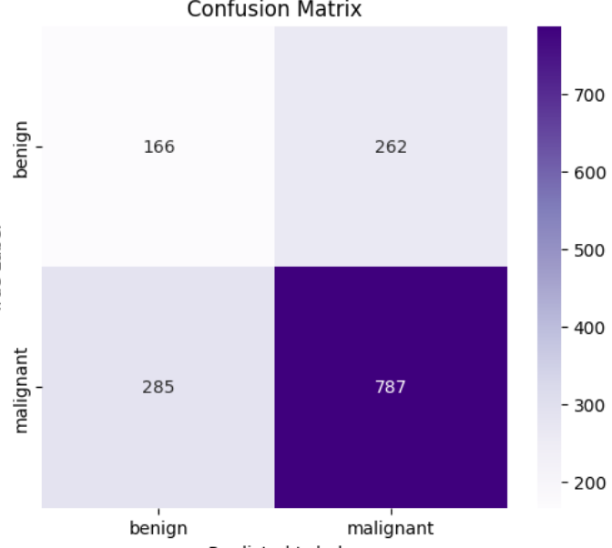
Logistic Regression Result
Accuracy: 63.53%
Precision: 0.6412
Recall (Sensitivity): 0.6353
F1-Score: 0.6381

Slide 10
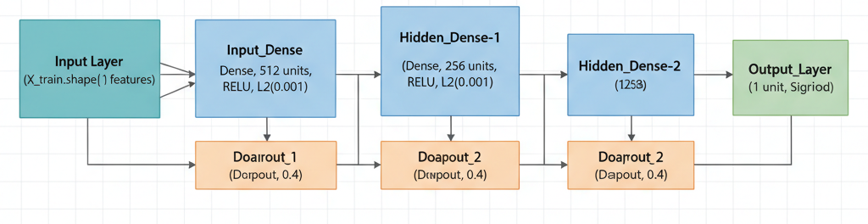
ANN Model
The proposed Dense ANN is designed for binary classification of thyroid images into benign and malignant categories. Each image is resized to 224×224×3 and flattened (150,528 features) before being input to the model.
The network consists of three dense layers with ReLU activations and dropout regularization (rate = 0.4) to prevent overfitting and improve generalization. It is trained end-to-end on normalized pixel data, enabling direct learning of feature-weight mappings without convolutional filters.

Slide 11
ANN Model
Architecture Overview:
Input: Flattened image (150,528 features)
Dense (512, ReLU) → Dropout (0.4)
Dense (256, ReLU) → Dropout (0.4)
Dense (128, ReLU)
Output: Dense (1, Sigmoid) → predicts malignant probability
Training Details:
Optimizer: Adam (lr = 0.001)
Loss: Binary Cross-Entropy
Batch size: 32, Validation split: 20%, EarlyStopping (patience = 5)

Slide 12
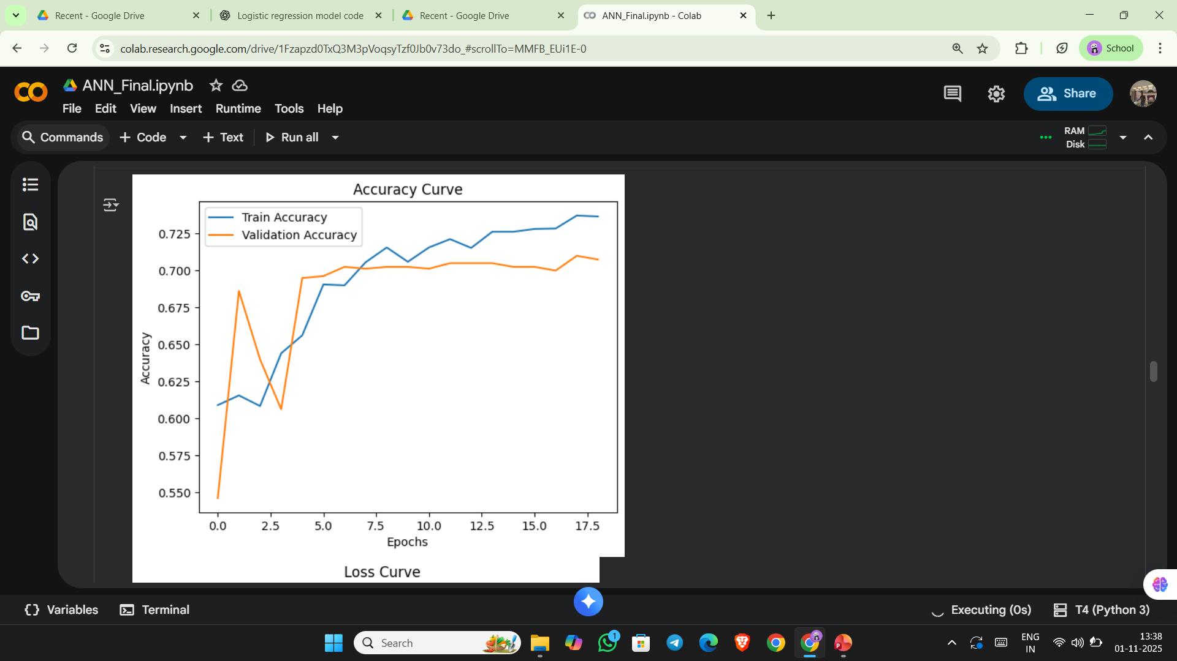
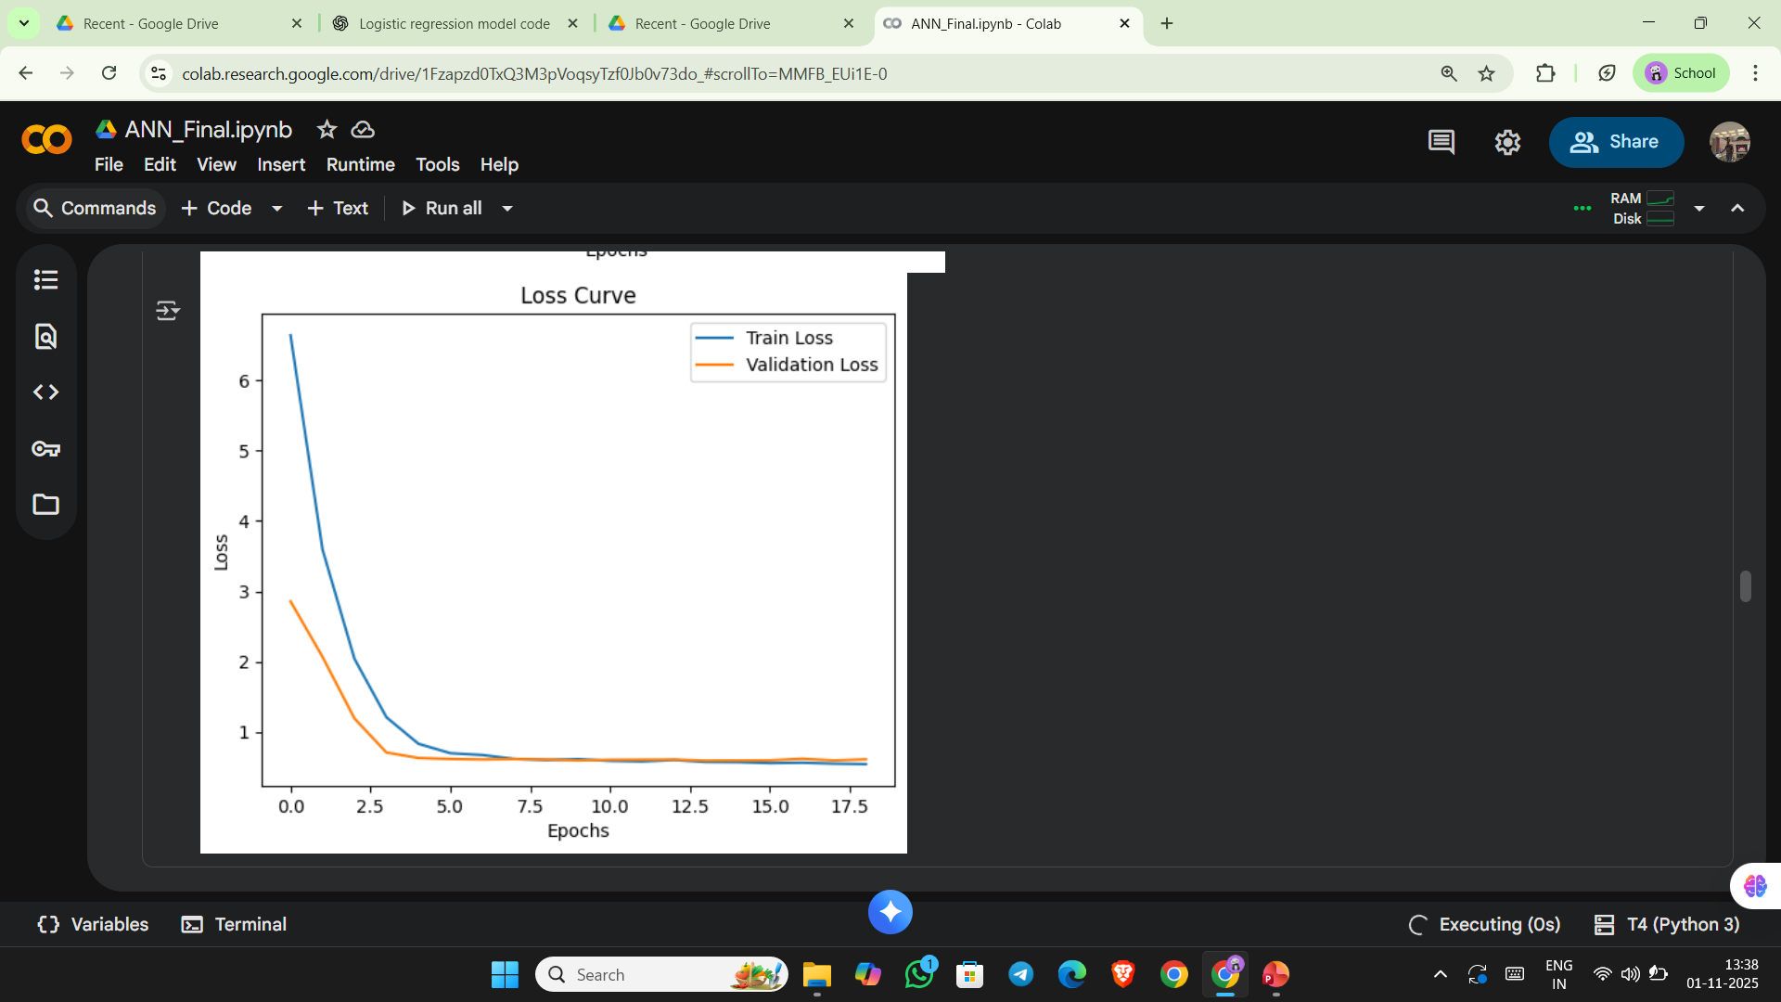
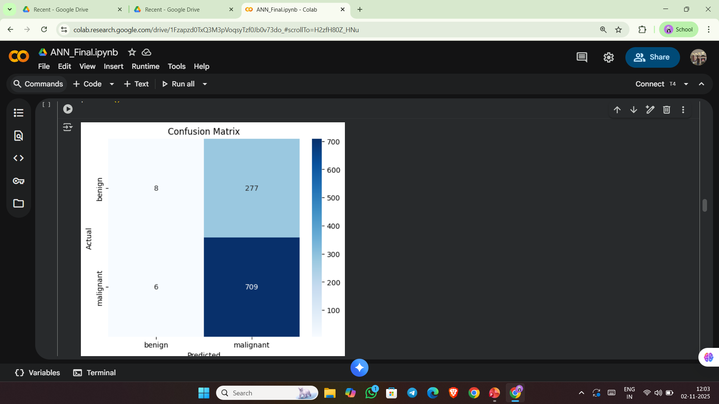
ANN Model Summary
Accuracy: 68.0%
Precision: 0.7595
Recall (Sensitivity): 0.8084
F1-Score: 0.7832
AUC (ROC): 0.6509

Slide 13
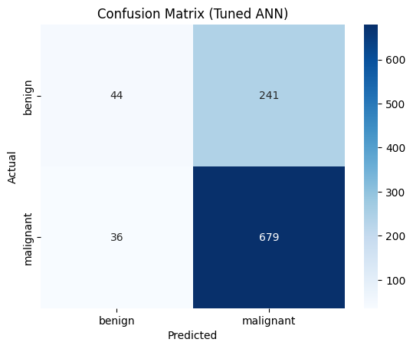
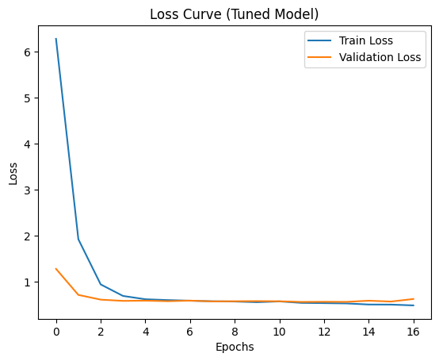
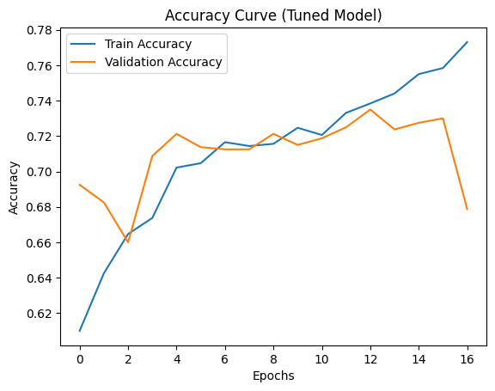
After Hyper-Parameter Tuning
Accuracy: 72.30%
Precision: 0.7380
Recall (Sensitivity): 0.7902
F1-Score: 0.8306
AUC (ROC): 0.6636

Slide 14
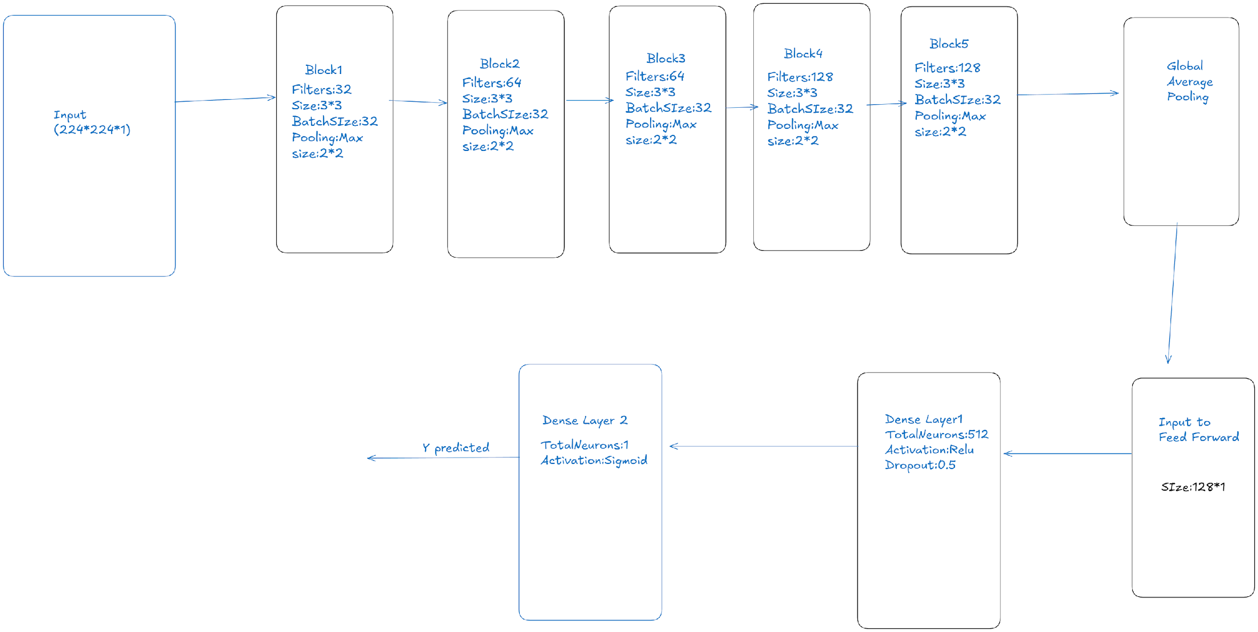
CNN

Slide 15
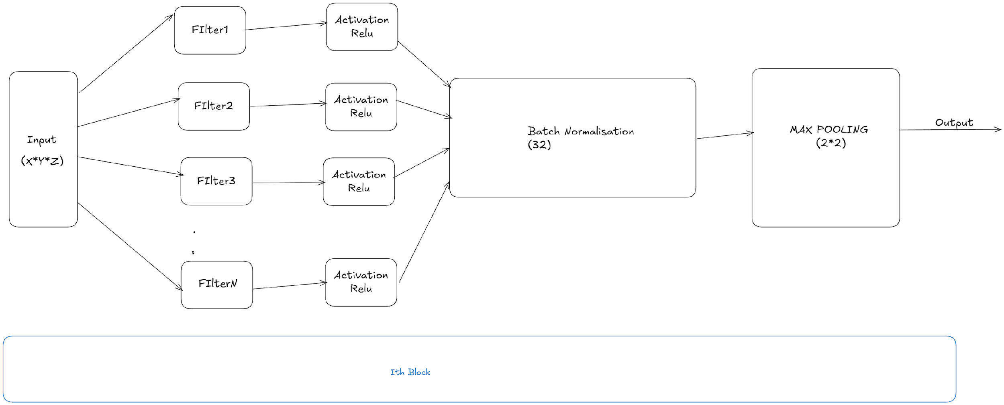
Block Description

Slide 16
CNN Model Summary
It consists of five convolutional blocks, each followed by Batch Normalization and MaxPooling to extract hierarchical visual features ranging from edges and textures to complex patterns.
Batch Normalization stabilizes training, while pooling layers progressively reduce spatial dimensions, retaining the most important activations.
A Global Average Pooling layer replaces traditional flattening to minimize parameters and enhance generalization by summarizing each feature map into a single value.
The extracted global features are fed into a fully connected dense layer of 512 neurons with ReLU activation to capture high-level relationships, followed by a Dropout layer to prevent overfitting.
Finally, a single sigmoid neuron outputs the probability for binary classification.

Slide 17
CNN Model Summary
The input dimensions of image which are fed to the network are 224*224*1
The network is trained using the Adam optimizer with learning rate=1e4.
A focal loss function is employed instead of the standard binary cross-entropy to effectively handle the issue of class imbalance in the dataset.By introducing parameters γ = 1.5 and α = 0.29, the focal loss down-weights the contribution of well-classified examples and focuses the learning process on harder, misclassified samples.
Class weights are applied during training to further counteract the uneven class distribution. This approach ensures that the model assigns higher importance to underrepresented classes, enhancing recall and balanced performance across categories.
A dropout factor of 0.5 was used
The final parameters and the metrics mentioned later have been obtained after the model underwent 10 trials of hyperparameter tuning using KerasTuner.

Slide 18
Performance on Test Data
Accuracy: 76.77%
Precision: 72.34%
Recall (Sensitivity): 80.09%
F1-score: 76.02%
AUC (ROC): 76.83%

Slide 19
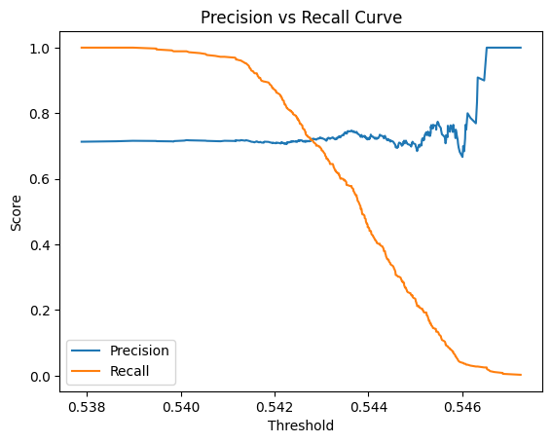
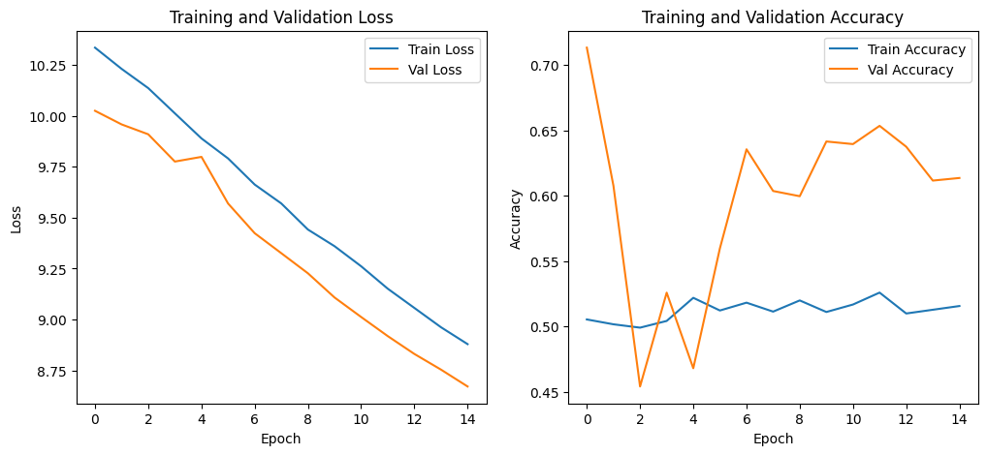
Results before Hyper-Parameter Tuning

Slide 20
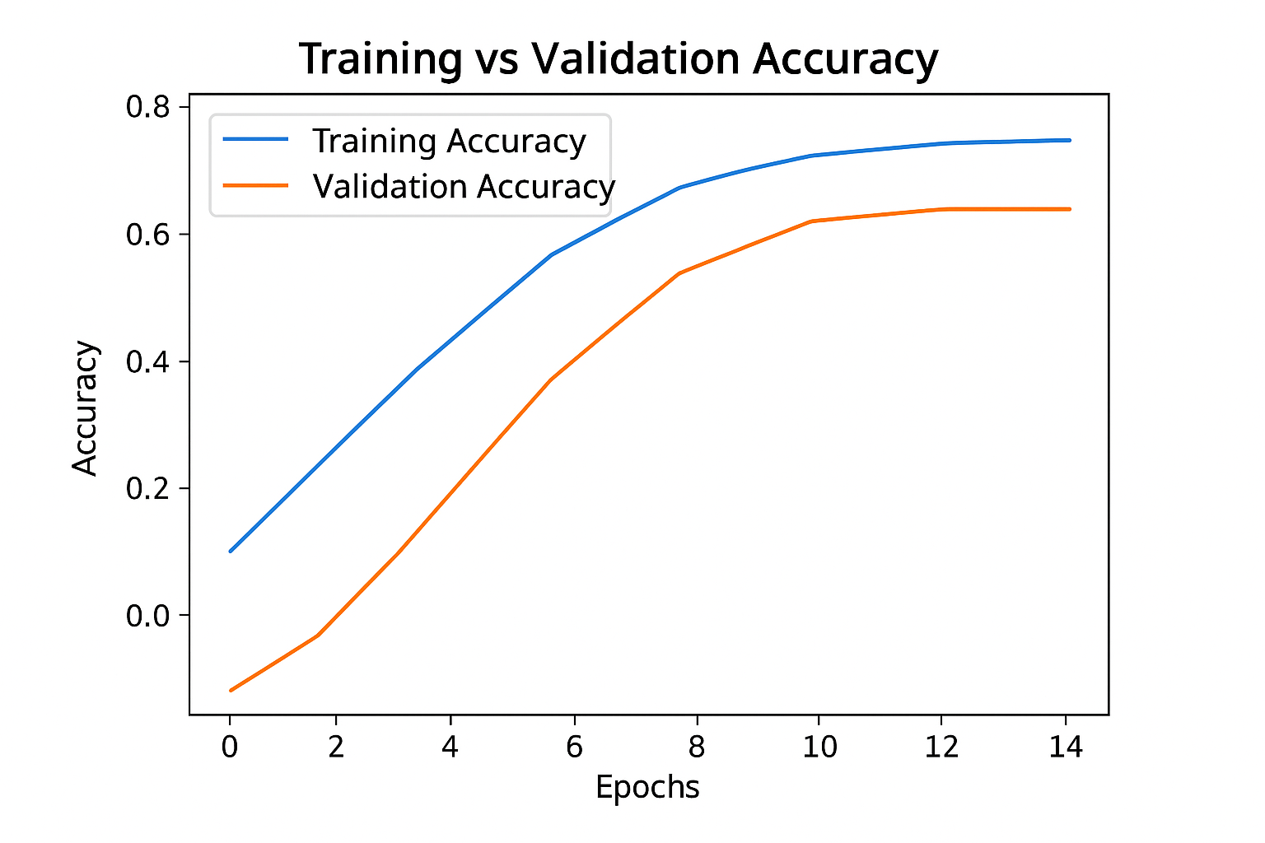
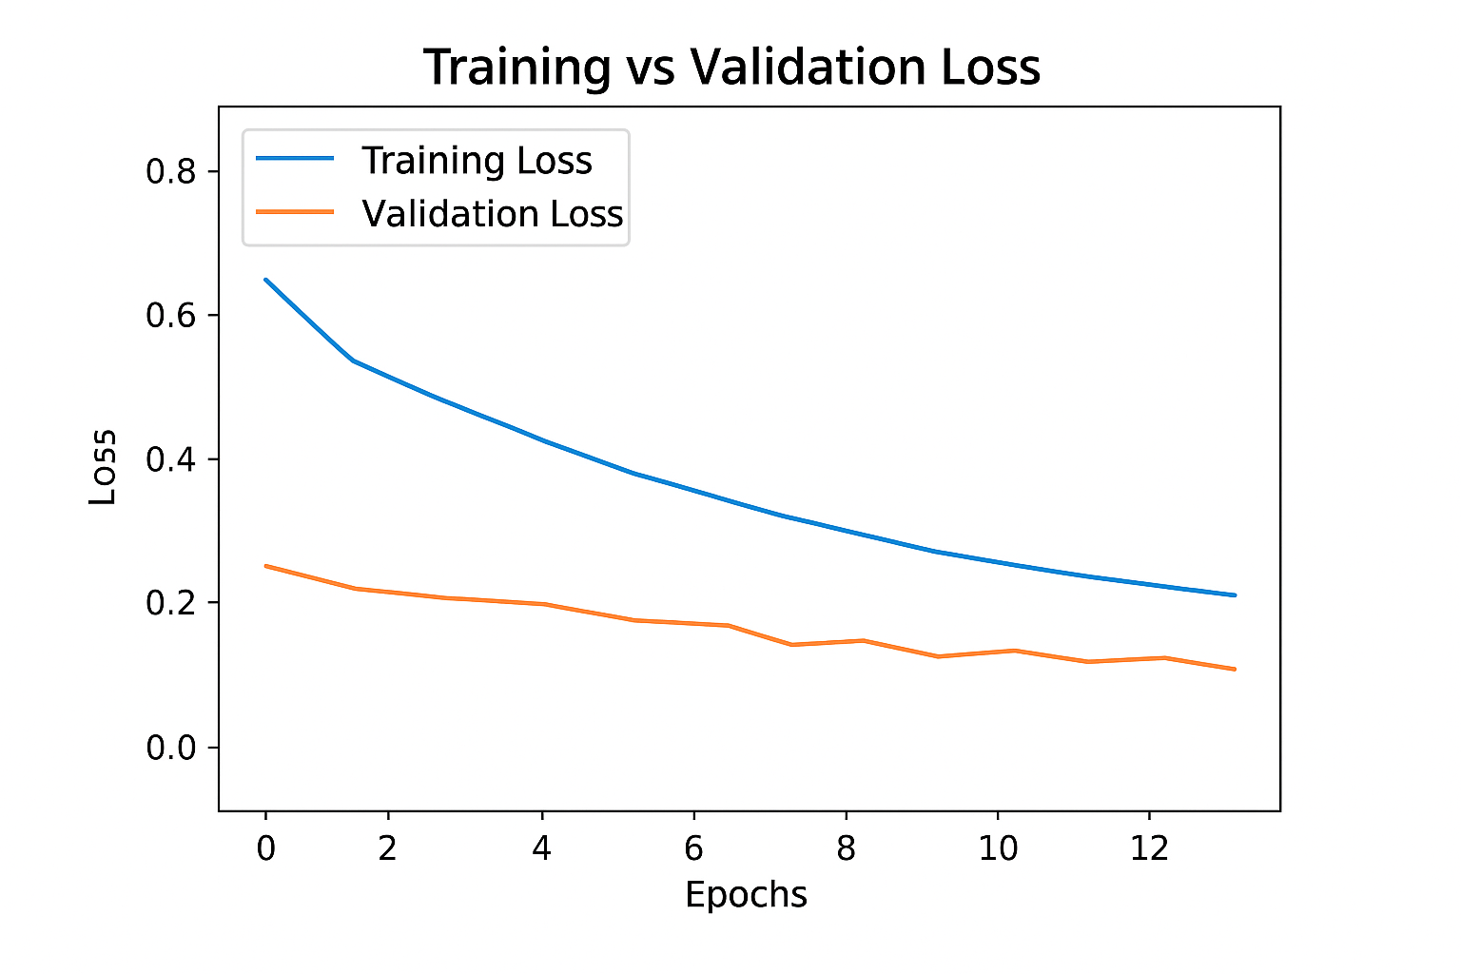
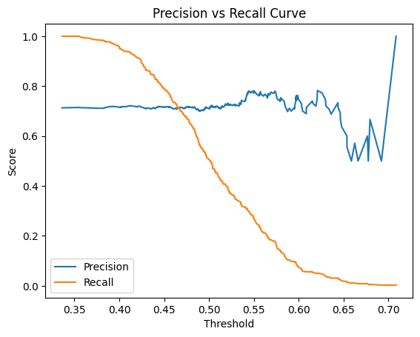
Results after Hyper-Parameter Tuning

Slide 21
Result Interpretation
The model achieved an accuracy of 76.77%, indicating that it correctly classified approximately three out of every four samples.
A precision of 72.34% shows that among all instances predicted as positive, about 72% were correctly identified, suggesting a moderate level of false positives.
The recall (sensitivity) of 80.09% demonstrates that the model successfully detected around 80% of actual positive cases, reflecting a strong ability to capture true positives.
With an F1-score of 76.02%, which balances precision and recall, the model exhibits well-rounded classification performance.
Finally, the AUC (ROC) value of 76.83% confirms that the model has a good ability to distinguish between the two classes overall.

Slide 22
Why transfer learning?
Medical datasets (like thyroid ultrasound) are usually small compared to datasets like ImageNet.
Transfer learning allows you to use knowledge from millions of pre-trained images, reducing the need for huge labeled medical data.
Early layers of VGG16 learn general features such as edges, textures, and shapes, which are also present in ultrasound images.
These generic features transfer well to your medical domain.
Since the base model already “knows” how to extract visual patterns, your model trains much faster and requires fewer epochs.

Slide 23
VGG-16
A deep Convolutional Neural Network (CNN) with 16 layers (13 convolutional + 3 fully connected).
Developed by The Visual Geometry Group (VGG) at the University of Oxford (Simonyan & Zisserman, 2014).
Uses small 3×3 convolution filters stacked together, which increases depth and improves feature learning.
Takes images of 224×224×3 as input (RGB) and is trained on ImageNet.

Slide 24
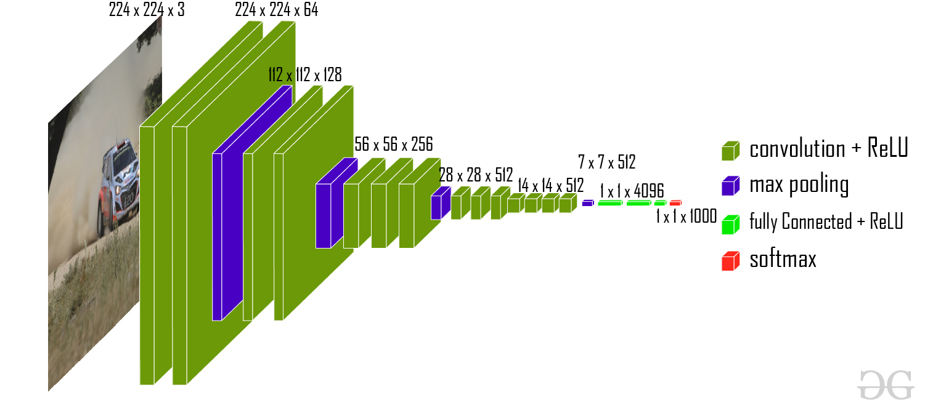

Slide 25
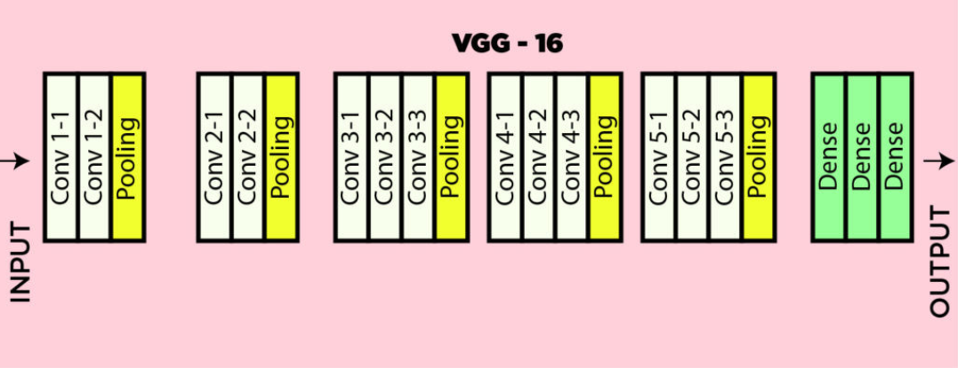

Slide 26
Proposed Model using VGG-16
The proposed model is based on transfer learning using VGG16 as the convolutional backbone.
The initial layers of VGG16 are frozen to retain general visual features such as edges, shapes, and textures.
The last four convolutional layers are unfrozen to allow fine-tuning and learning of domain-specific ultrasound patterns.
A data augmentation block is included at the beginning of the model to enhance generalization and prevent overfitting through random flips, rotations, zooms, and contrast variations.
The extracted feature maps are flattened and passed to a dense layer of 256 neurons with ReLU activation, allowing the network to learn complex non-linear relationships.

Slide 27
Proposed Model using VGG-16
A dropout layer (rate = 0.6) is applied for regularization to reduce overfitting.
The final output layer consists of a single neuron with sigmoid activation, producing a probability score for binary classification (benign vs malignant).
The model is trained using the Adam optimizer (learning rate = 1e-5) and binary focal loss, with evaluation metrics including accuracy, precision, recall, F1-score, and AUC.
The number of neurons, dropout rate, and other architectural parameters were optimized through hyperparameter tuning

Slide 28
Performance and Results
The VGG16-based transfer learning model achieved strong classification performance on the thyroid ultrasound dataset.
After applying data augmentation, class weighting, and fine-tuning of the last convolutional layers, the model demonstrated excellent generalization capability.
On the test dataset, the model achieved:
Accuracy: 80.20%
Precision: 86.84%
Recall (Sensitivity): 84.98%
F1-score: 85.90%
AUC (ROC): 85.17%

Slide 29
Result Interpretation
The high accuracy and F1-score indicate balanced and reliable performance across both benign and malignant classes.
A high recall (≈85%) shows the model successfully identifies most malignant nodules, minimizing false negatives — which is crucial for clinical applications.
The AUC of 0.85 confirms strong discriminatory power between benign and malignant cases.
Overall, the model effectively combines transfer learning and fine-tuning to achieve robust and clinically meaningful results, showing promise as a diagnostic support tool for thyroid nodule assessment.

Slide 30
Conclusion
In this project, an AI-based Computer-Aided Diagnosis (CAD) system was developed to classify thyroid nodules as benign or malignant using ultrasound images.
Multiple deep learning models — including Logistic Regression, ANN, CNN, and VGG16 (Transfer Learning) — were trained and evaluated.
Among them, the VGG16-based transfer learning model achieved the best performance.\
These results demonstrate that deep learning models can effectively capture subtle patterns in thyroid ultrasound images that may not be easily detected by human observation.
By incorporating techniques such as data augmentation, class weighting, and focal loss, the system successfully addressed the class imbalance problem and improved malignant nodule detection, which is clinically critical.
Overall, the developed system shows strong potential as a decision-support tool for radiologists, reducing diagnostic subjectivity and improving screening efficiency.

Slide 31
Future Work
Use a larger and more diverse dataset to improve generalization and reduce bias.
Test other modern architectures such as EfficientNet, ResNet50 etc to assess performance improvements.
Extend the model to handle 3D ultrasound sequences or temporal features, which could reveal dynamic tissue behavior.
Develop a web or mobile-based diagnostic interface to assist radiologists in real time.

Slide 32
References
Ultrasound-based classification of follicular thyroid Cancer using deep convolutional neural networks with transfer learning- Enock Adjei Agyekum, Zhang Yuzhi, Yu Fang, Doris Nti Agyekum, Xian Wang, Eliasu Issaka, CuiRong Li, Xiangjun Shen, Xiaoqin Qian & Xinping Wu3
https://www.nature.com/articles/s41598-025-05551-7
A deep learning based ultrasound diagnostic tool driven by 3D visualization of thyroid nodules https://www.nature.com/articles/s41746-025-01455-y

